Slide 1
Electronic Devices
Mid Term Lecture - 10
Faculty Name: Dr. Mohammad Alif Arman
Email : dr.alifarman@aiub.edu
Room: DN0526
Reference book:
Electronic Devices and Circuit Theory (Chapter-4)
Robert L. Boylestad and L. Nashelsky , (11th Edition)

Slide 2
Objectives
Be able to determine the dc levels for the variety of important BJT configurations.
Understand how to measure the important voltage levels of a BJT transistor configuration and use them to determine whether the network is operating properly.
Become aware of the saturation and cutoff conditions of a BJT network and the expected voltage and current levels established by each condition.
Be able to perform a load-line analysis of the most common BJT configurations.
Become acquainted with the design process for BJT amplifiers.
Understand the basic operation of transistor switching networks.
Begin to understand the troubleshooting process as applied to BJT configurations.
Develop a sense for the stability factors of a BJT configuration and how they affect its operation due to changes in specific characteristics and environmental changes.

Slide 3
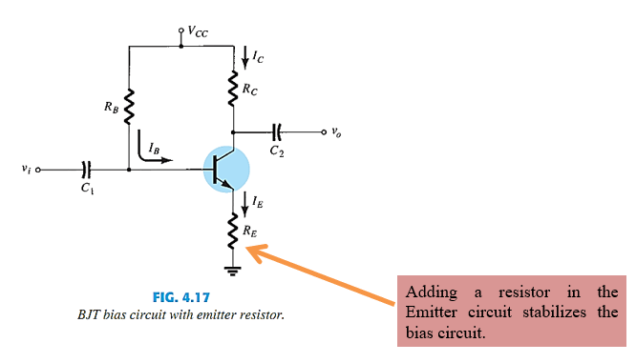
EMITTER-BIAS CONFIGURATION

Slide 4
BIAS STABILITY
If V_{BE} is held constant and the temperature rises, the current through the base-emitter diode I_{B} will increase, and thus the collector I_{C} will also increase. The power dissipated in the transistor may also increase, which will further increase its temperature and exacerbate the problem. This deleterious positive feedback results in thermal runaway.
Adding R_{E} to the Emitter improves the stability of a transistor.
Stability refers to a bias circuit in which the currents and voltages will remain fairly constant for a while range of temperatures and transistor Beta’s (β).
V_{RB} = V_{CC} – I_{E}R_{E} – V_{BE}

Slide 5
BIAS STABILITY
If temperature increases, emitter current increases.
However, a larger I_{E} increases the emitter voltage V_{E} =I_{E}R_{E}, which in turn reduces the voltage V_{RB} across the base resistor.
A lower base-resistor voltage drop reduces the base current, which results in less collector current because I_{C} = βI_{B}.

Slide 6
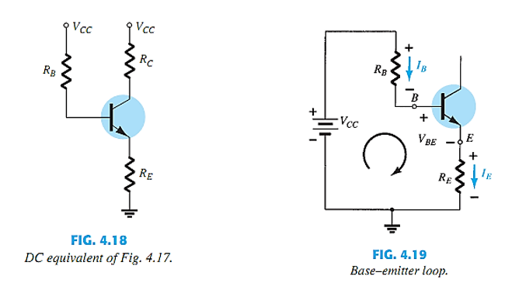
BASE–EMITTER LOOP

Slide 7
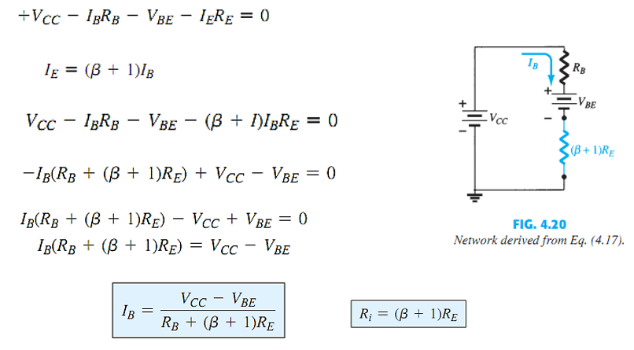
BASE–EMITTER LOOP

Slide 8
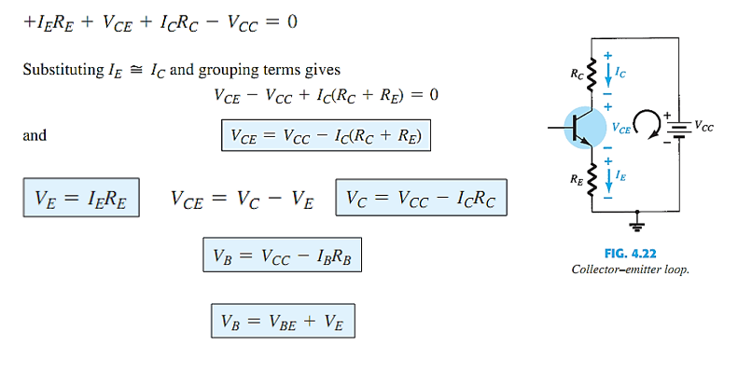
COLLECTOR–EMITTER LOOP

Slide 9
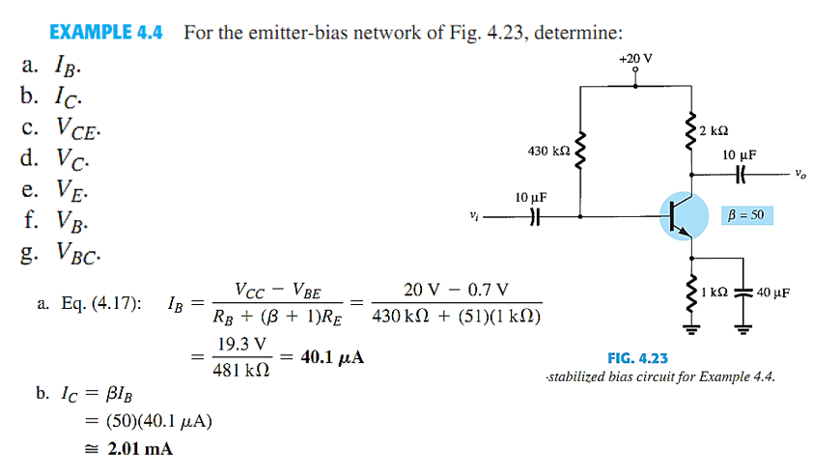
EXAMPLE

Slide 10
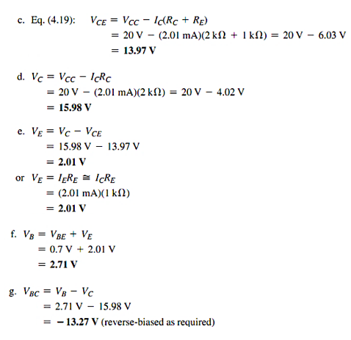
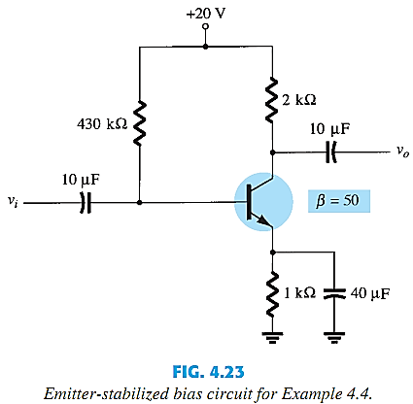
EXAMPLE

Slide 11
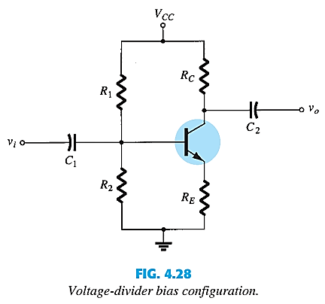
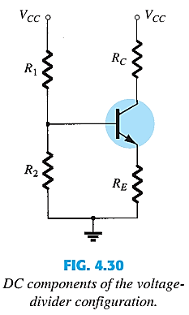
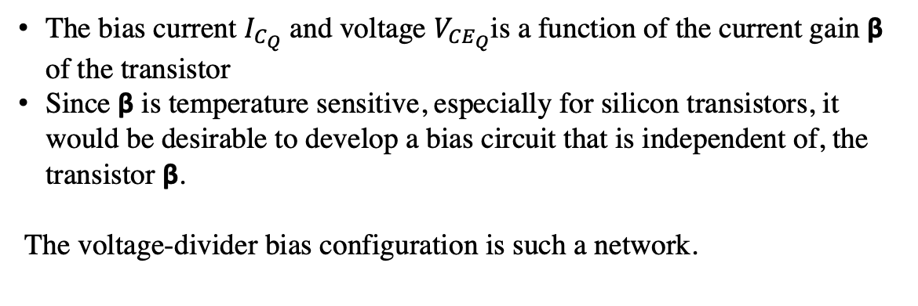
VOLTAGE-DIVIDER BIAS CONFIGURATION
The bias current $I_{C_{Q}}$ and voltage $V_{{CE}_{Q}}$is a function of the current gain β of the transistor
Since β is temperature sensitive, especially for silicon transistors, it would be desirable to develop a bias circuit that is independent of, the transistor β.
The voltage-divider bias configuration is such a network.

Slide 12
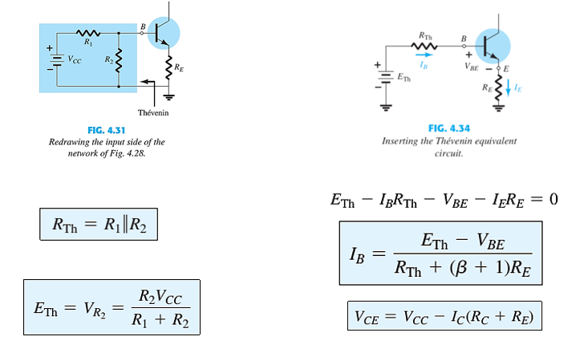
EXACT ANALYSIS

Slide 13
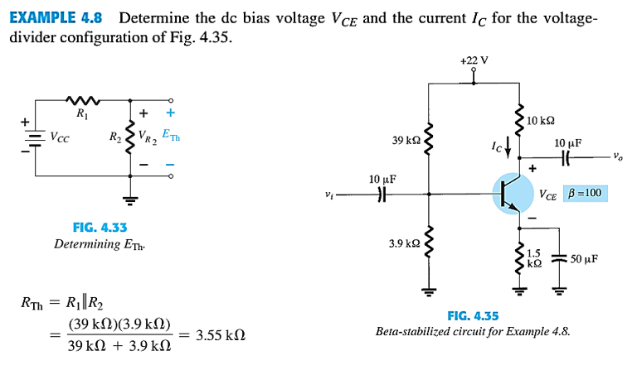
EXAMPLE

Slide 14
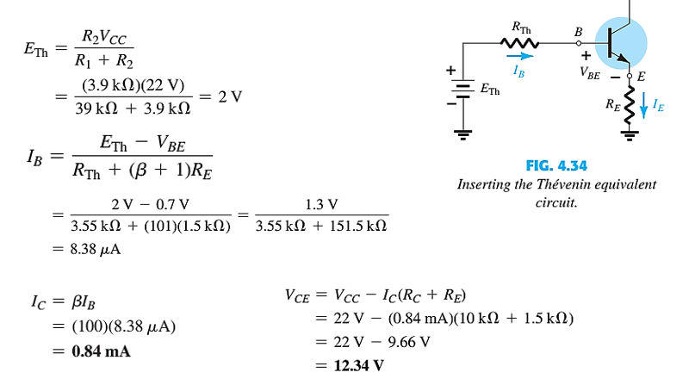
EXAMPLE CONTD.

Slide 15
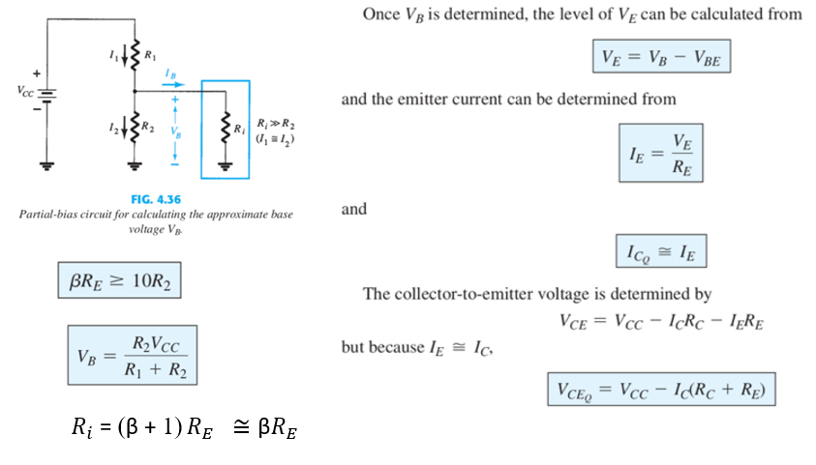
Approximate Analysis

Slide 16
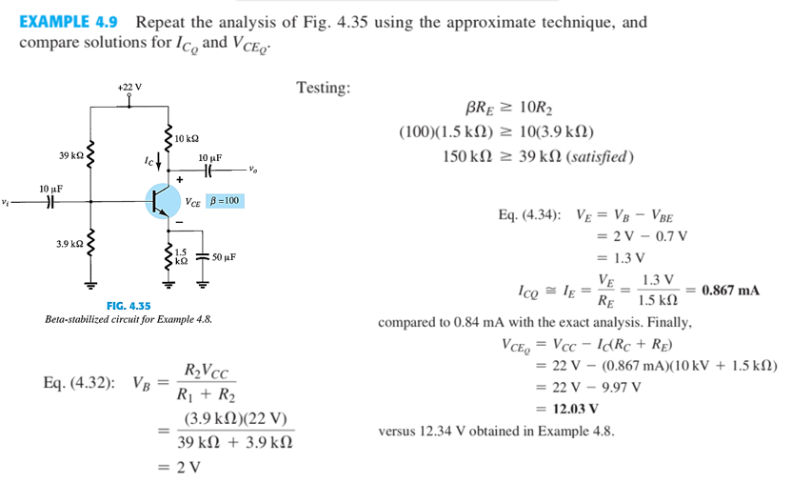
EXAMPLE

Slide 17
COLLECTOR FEEDBACK CONFIGURATION
An improved level of stability can also be obtained by introducing a feedback path from collector to base
Although the Q-point is not totally independent of beta (even under approximate conditions), the sensitivity to changes in beta or temperature variations is normally less than encountered for the fixed-bias or emitter-biased configurations.
The analysis will again be performed by first analyzing the base–emitter loop, with the results then applied to the collector–emitter loop

Slide 18
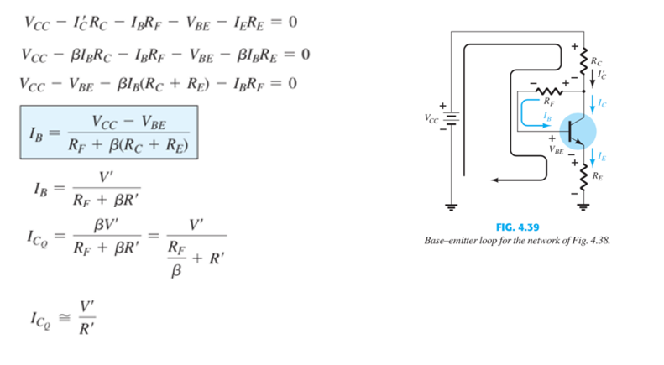
BASE–EMITTER LOOP

Slide 19
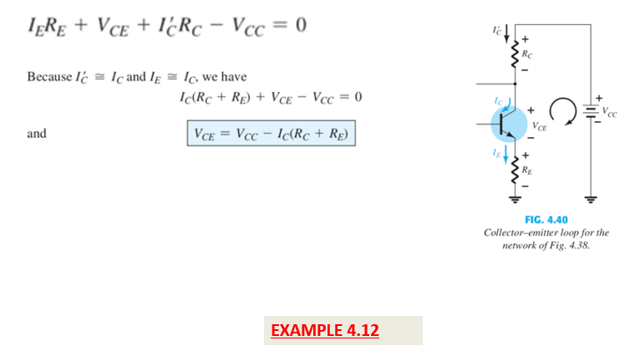
COLLECTOR–EMITTER LOOP

Slide 20
Thank You

